Slide 1
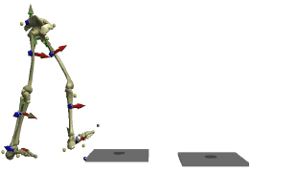
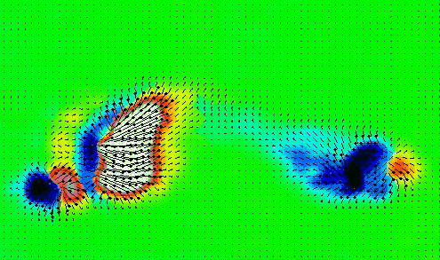
Lab 3: Gait Analysis
Aiswarya, Jared, Mattia,Mohab

Slide 2
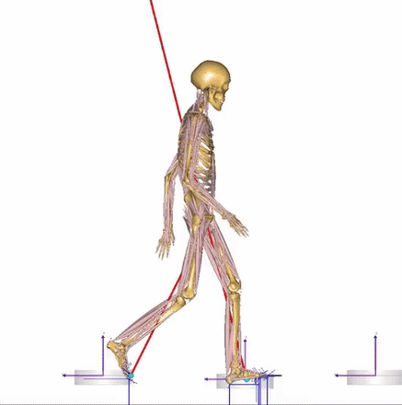
Data requirements
Step and Stride Length
Step count
Cadence
Speed
Notes:
Step and Stride Length are physically measured
Step count calculated whenever user’s heel touches the ground
Cadence recorded over 10 seconds, multiplied by 12
Cadence * Step Length = Speed

Slide 3
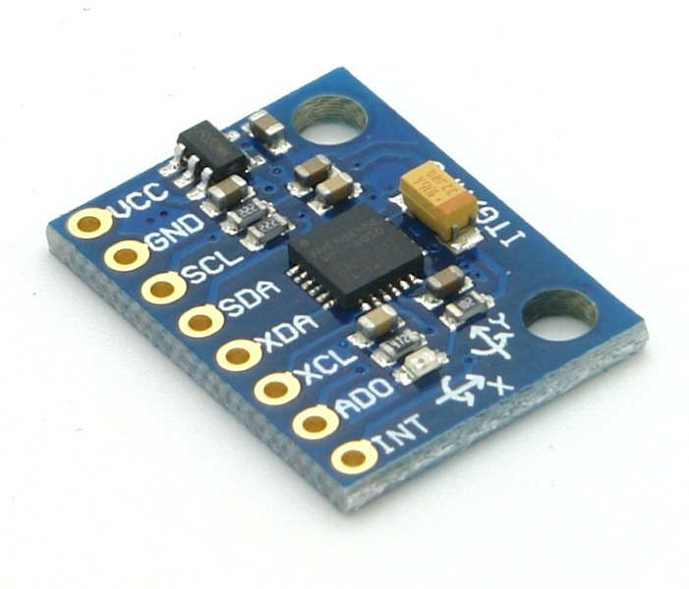
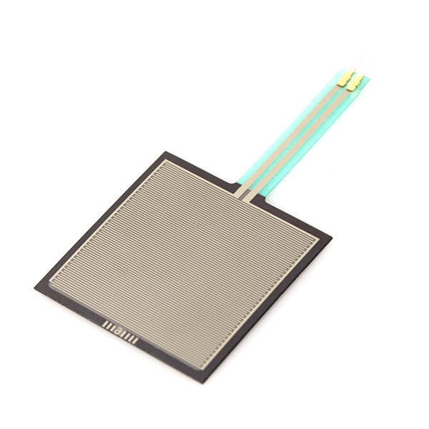
Hardware:
LED’s with force resistors
Use of Velcro
Accelerometer - movement, balance control

Slide 4
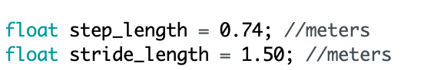
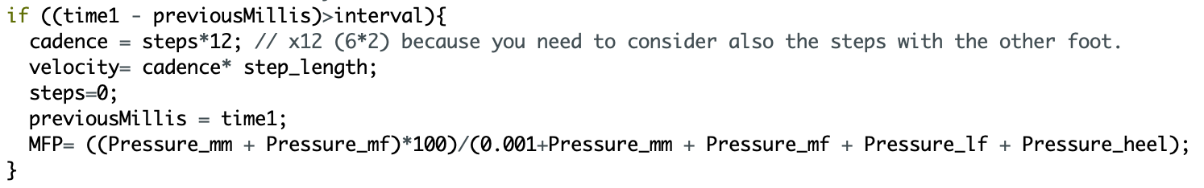
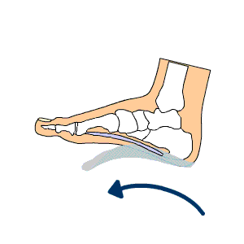
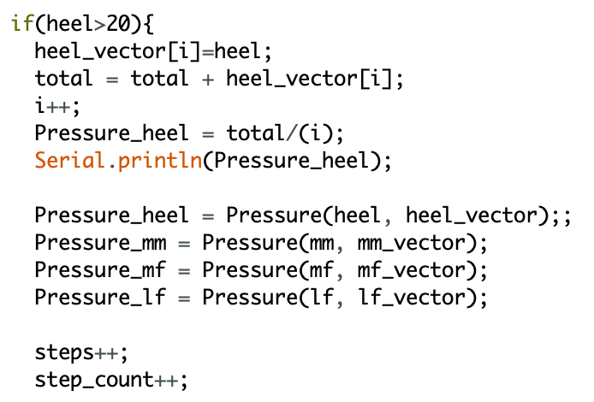
Data Collection

Slide 5
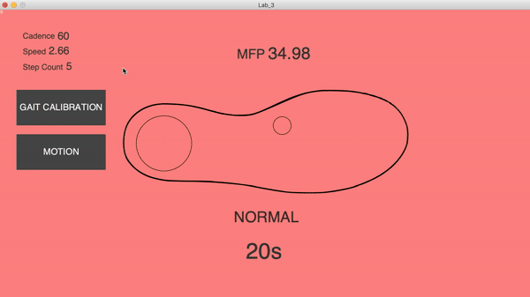
Normal Walking
Notes:
EXPLAIN ALL THE PARAMETERS IN THE GUI

Slide 6
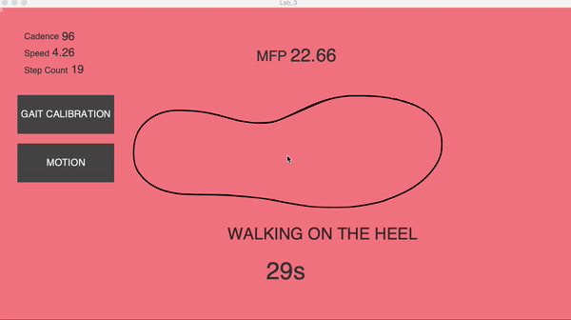
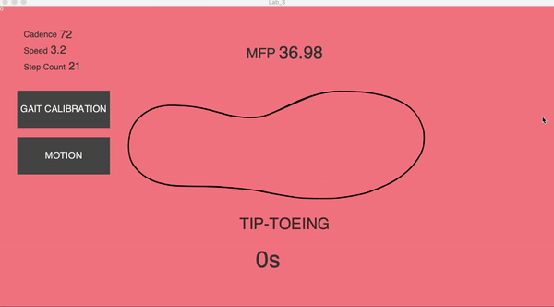
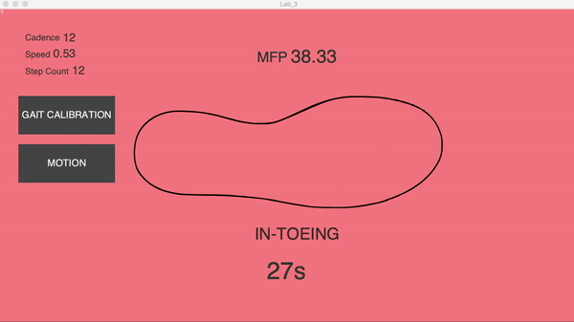
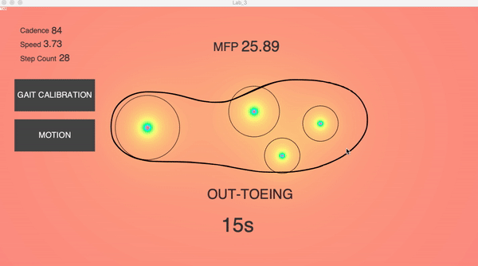
User’s Profile Walking
Notes:
In arduino we collect data for each of the walking for 30 seconds, we’ll use these data for the random walking which jared will explain.
HEEL: pressure only sensed by heel sensor
Tip toeing: all the pressure on the forward part of the foot. More pressure on MF, some pressure sensed in LF
Intoeing: LF and MF sense the pressure before MM and heel. LF sense the major pressure among the sensors
OUTTOEING:: pressure is sensed at its highest value by mm and also by heel sensor. Pressure sensed also by the other 2 sensors, but less.

Slide 7
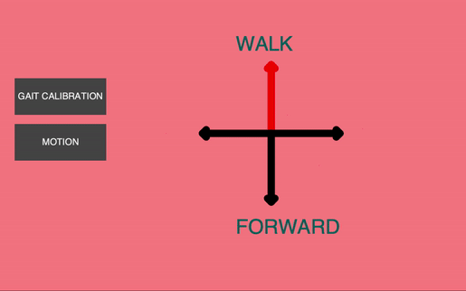
Accelerometer
BLACK arrows -> patient is standing STILL
RED arrow - patient is moving - the arrow indicates WHERE he is moving
Notes:
We used

Slide 8
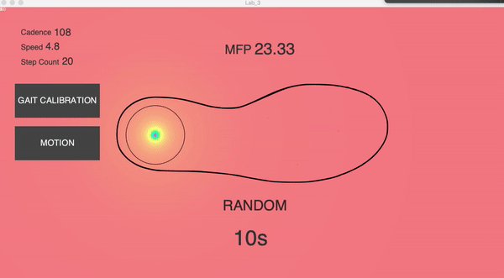
Random
Let’s the computer predict the user’s profile walking
HOW? - Storage of data - Comparison with the previous profiles
Notes:
Random: during this modality Processing stores all the data coming from Arduino. After 30 seconds it starts comparing these data with the data collected in the previous walking modalities. Then it says in which way you walked during Random modality.

Slide 9
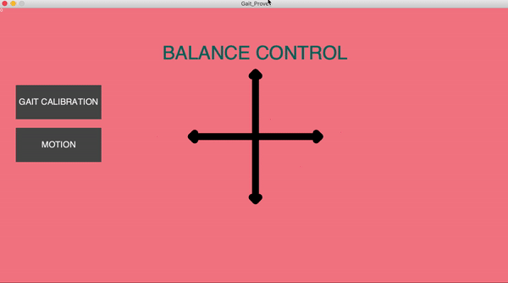
Balance Control
MODALITIES
Open eyes
Closed eyes
RESULTS: when the patient closes his eyes, he has less control on its balance

